Slide 1
Performance analysis of multi-threading in In-Memory Data-Stores
Grégory Ludovic Maitre
Patrick Daniel Oliveira Andrade
29st May 2015

Slide 2
Outline
What is a Key-Value Store
Goal
Load and metrics
Factors
Method
Experiments
Numerical Analysis
Conclusion

Slide 3

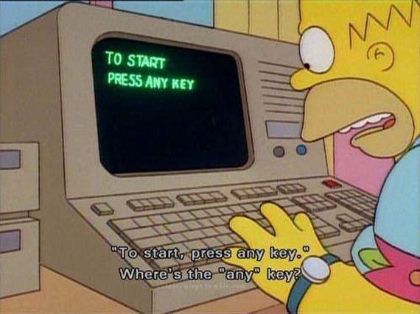
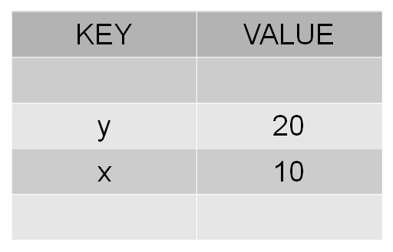
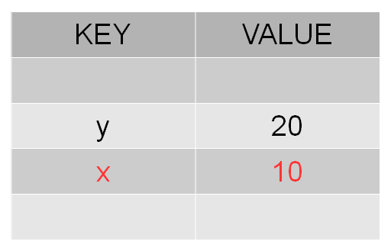
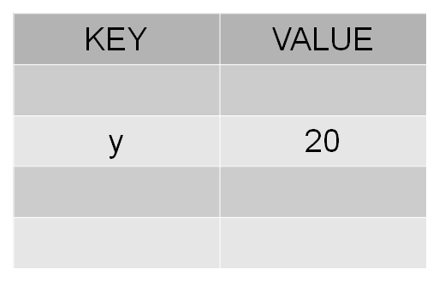
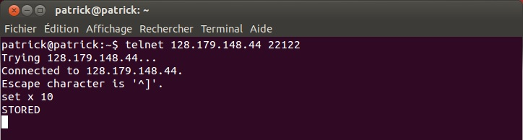
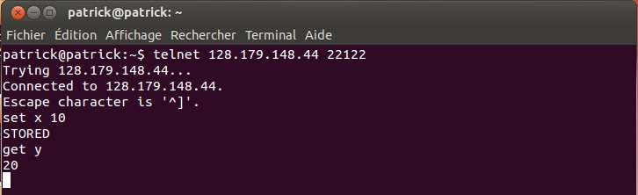
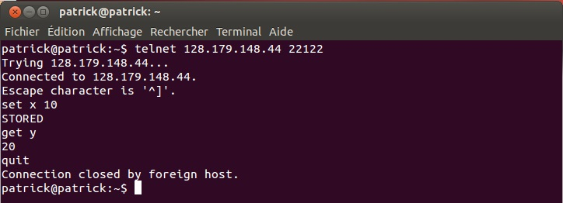
Quick example of a Key-Value store
Notes:
3

Slide 4
Key-Value Store
Single Threaded vs Multi Threaded
Blocking version vs Pipelined version
Standard Java IO vs Java NIO
Different Lock Mechanisms
Global Lock
Key Lock
Maps Lock
No Lock
Example: NIOMultiGlobalLock

Slide 5
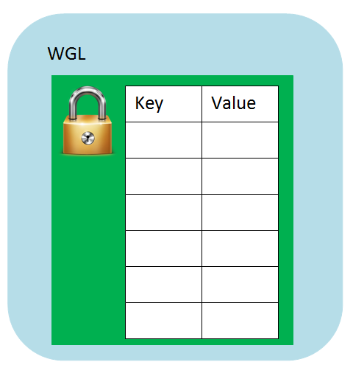
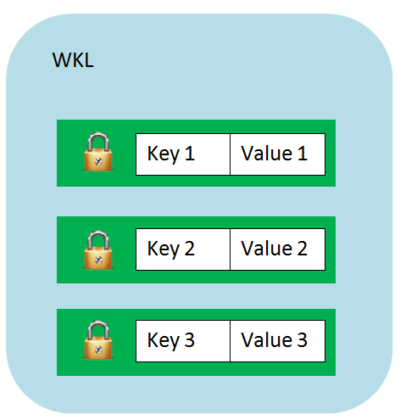
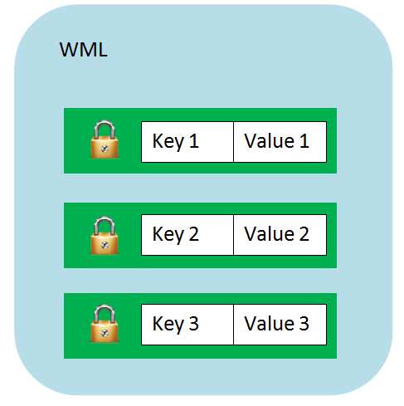

Lock Mechanism
LocksHelper

Slide 6
Goal
Evaluate the performance of all the architectures of In-Memory Data-Stores that we built
Compare the performances between the different architectures
Give suitable architecture depending on average clients served
Performance analysis will be, in this case, analysis of the average waiting time of a client for an answer after performing a request to the data-store

Slide 7
Load and metrics
Load generated by benchmarks that send randomly requests to get/set data with some random key in a range of one hundred predefined keys and with some random value in a range of one hundred predefined values.
Metric is the average response time of any request to the different data-stores

Slide 8
Factors
Network (WIFI/Ethernet)
System load (one server machine and one client machine)

Slide 9
Method
As previously mentioned, running benchmarks to evaluate the average waiting time for an answer coming from the data-store.

Slide 10
Experiments
1 to 500 clients (step of 1) each sending 100 randomized requests over WIFI and Ethernet network.
1 to 500 clients (step of 20) each sending 100 randomized requests over Ethernet network. Each experiment is done 20 times.
Set the number of clients (10, 25, 50, 300), each sending 100 requests over Ethernet. Each experiment is done 300 times.

Slide 11
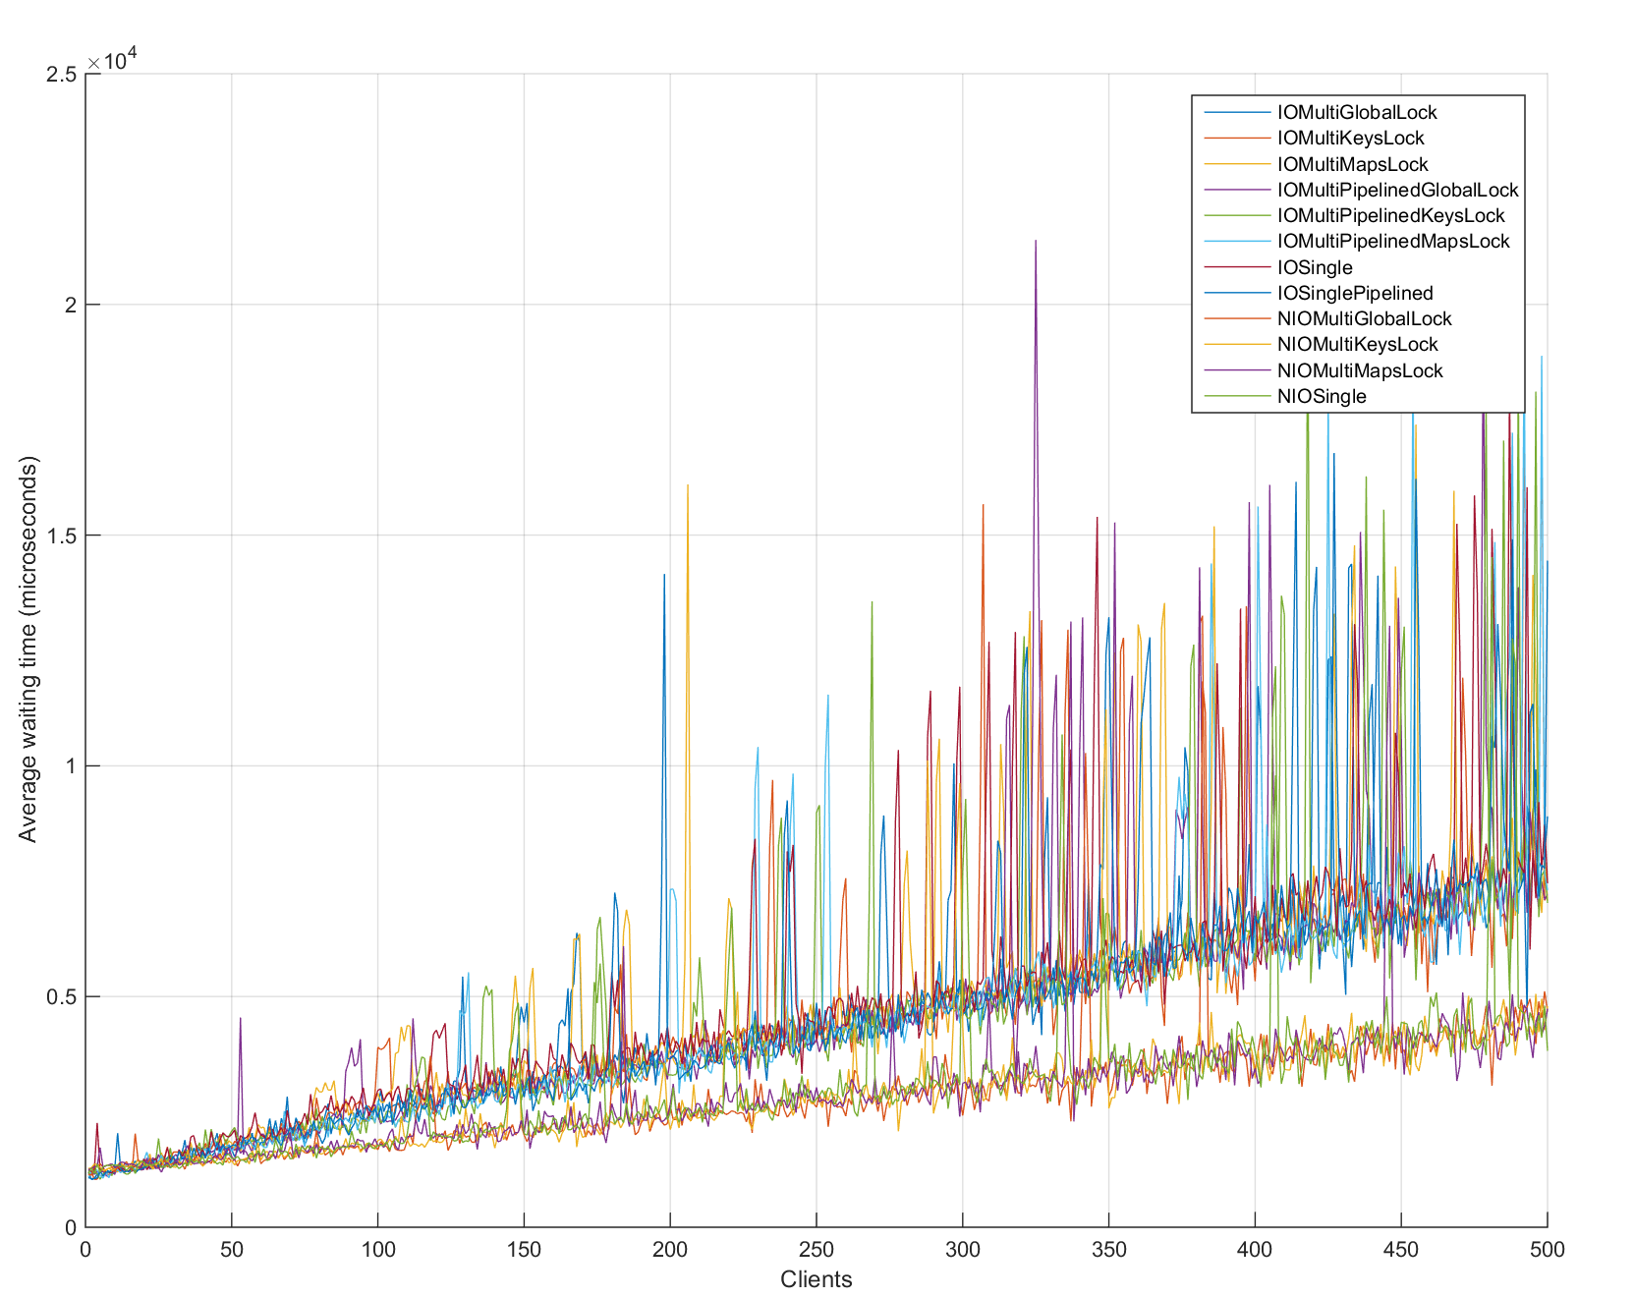
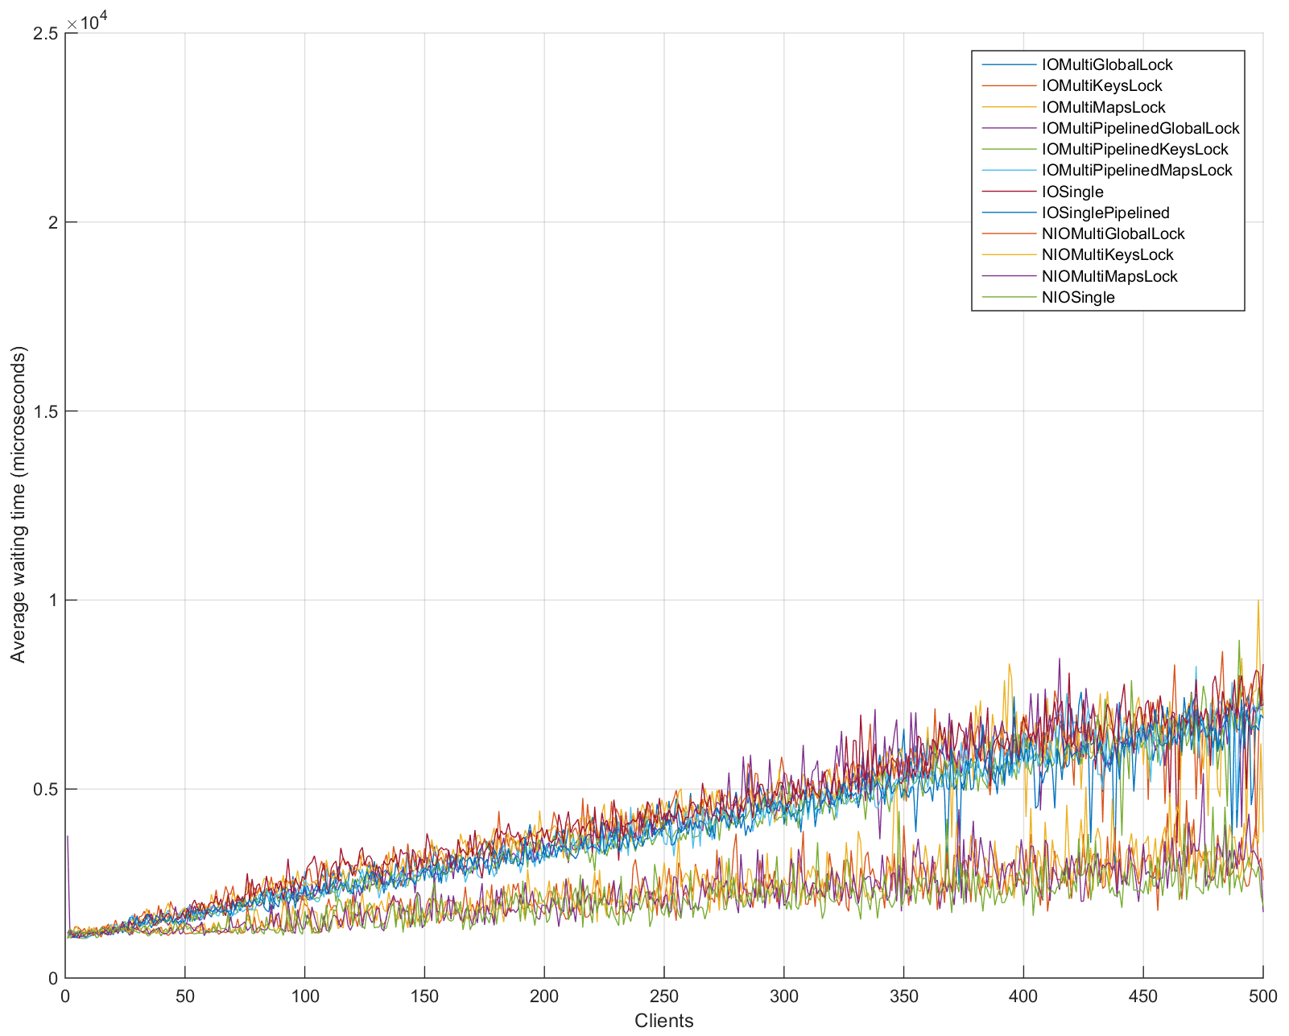
Numerical analysis: 1 to 500 clients
WIFI vs Ethernet

Slide 12
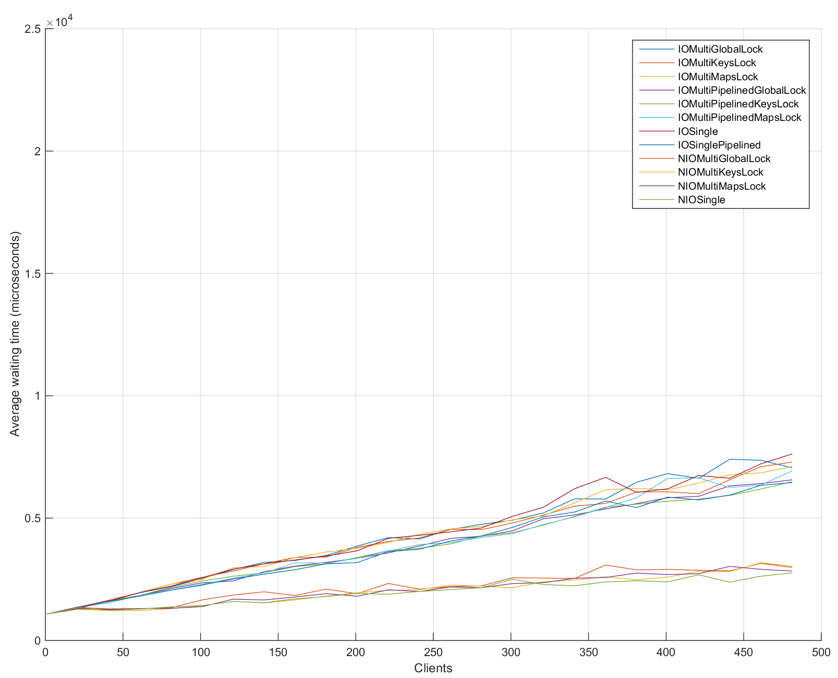
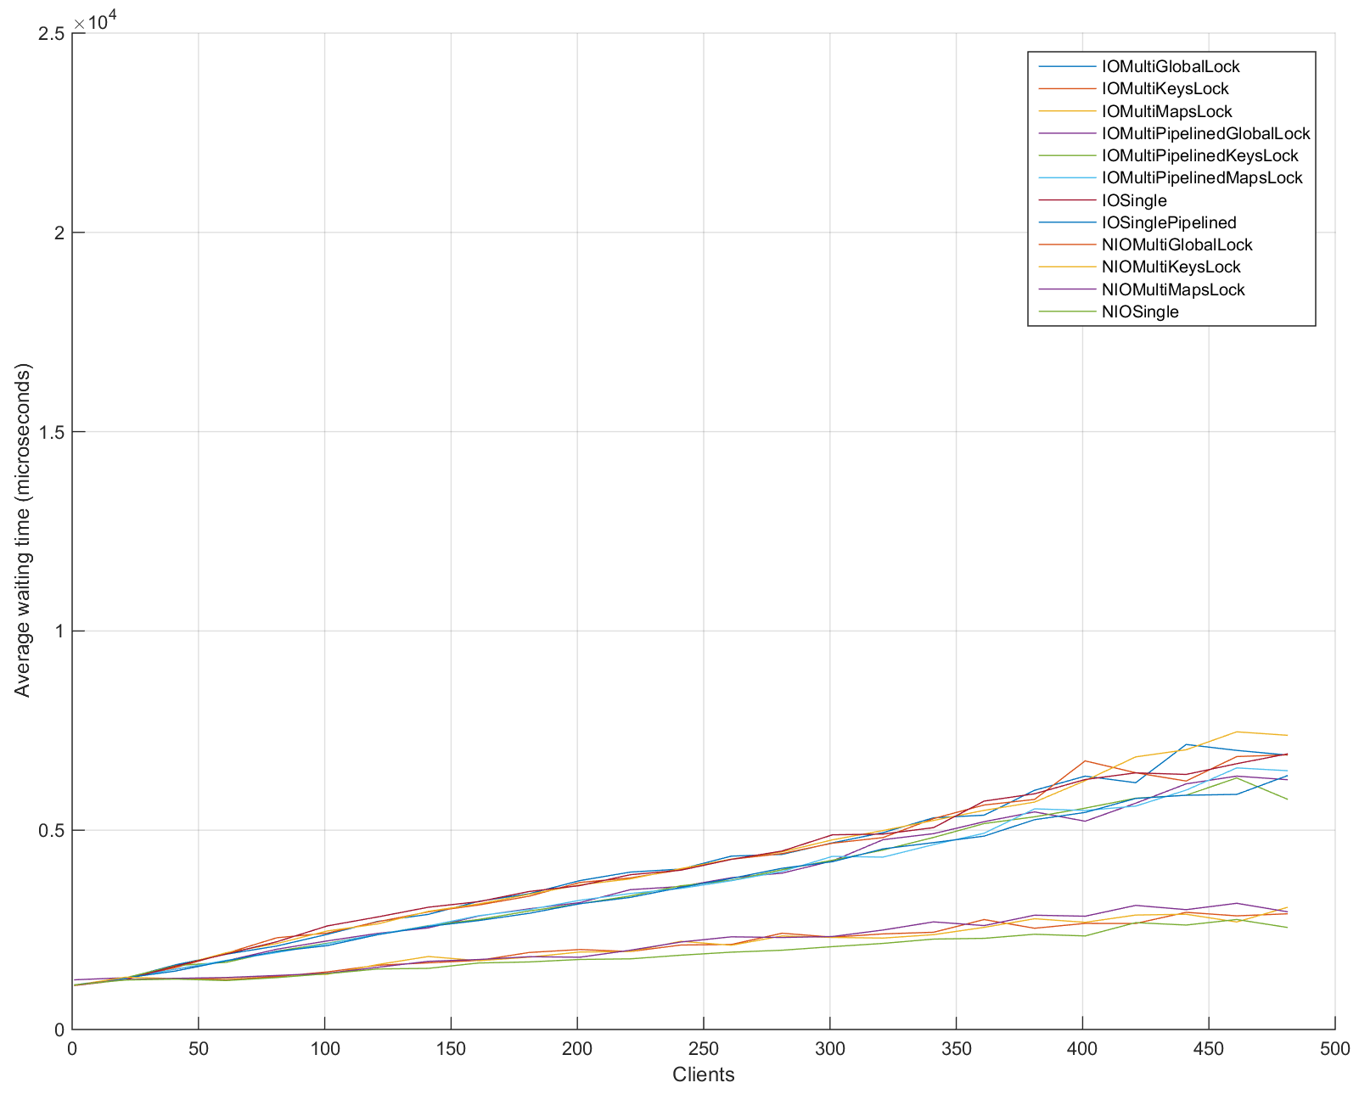
1 to 500 clients
Mean & Median

Slide 13
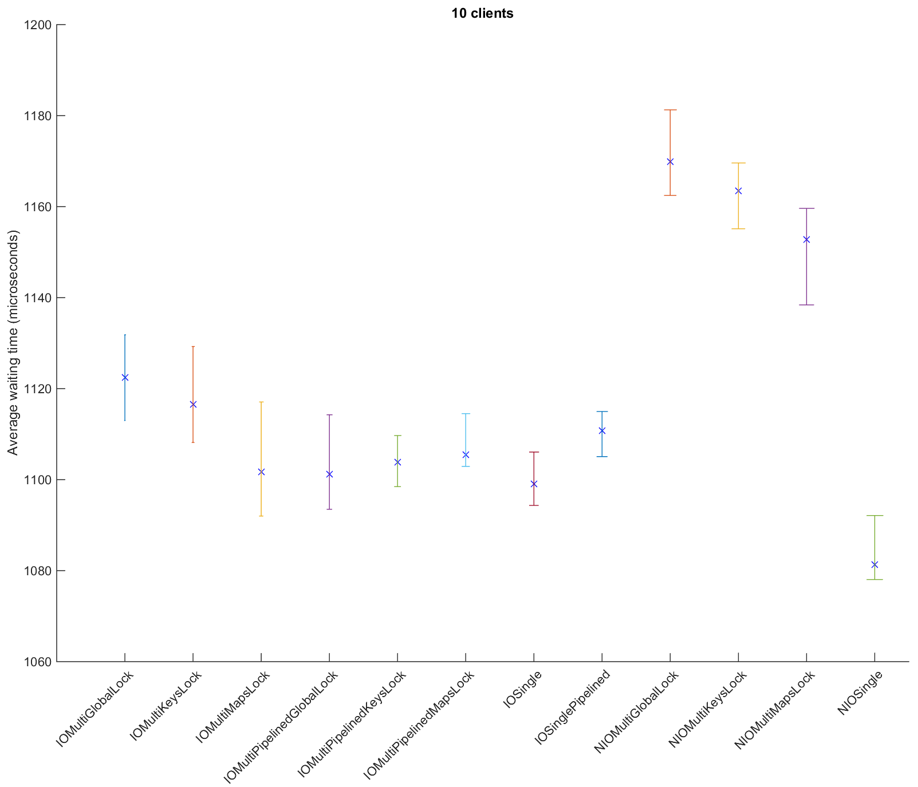
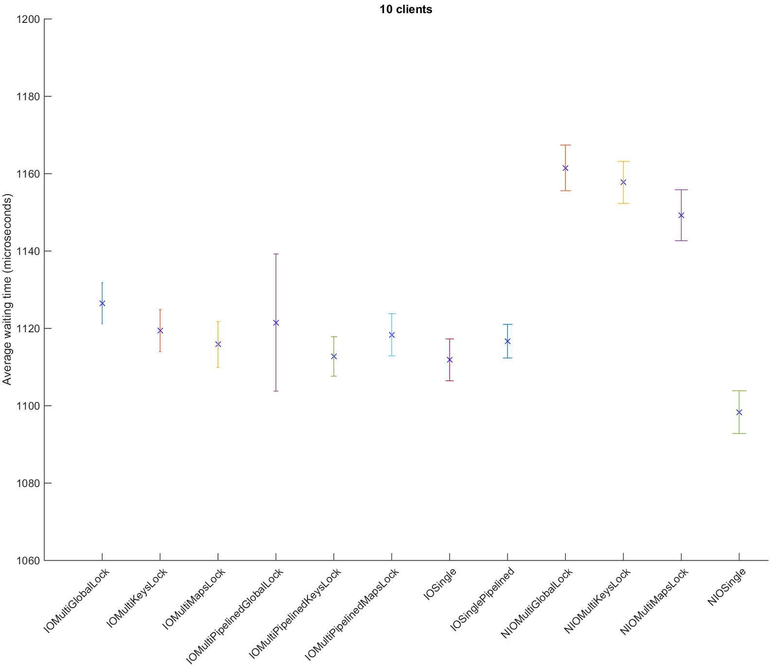
Confidence Intervals 10 clients

Slide 14
Confidence Intervals 25 clients

Slide 15
Confidence Intervals 100 clients

Slide 16
Confidence Intervals 300 clients

Slide 17
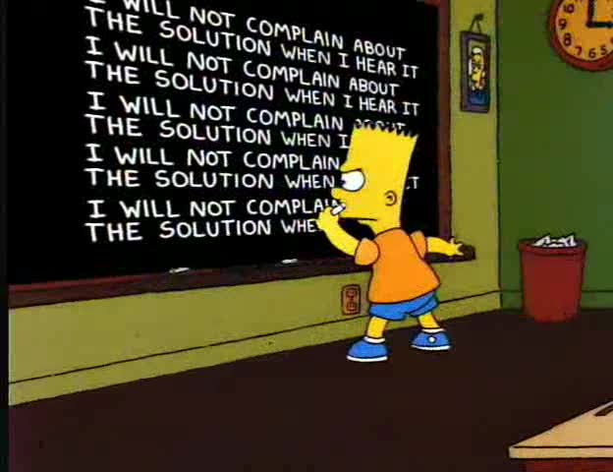
Conclusion
Blabla.
Bla.

